Slide 1



Slide 2
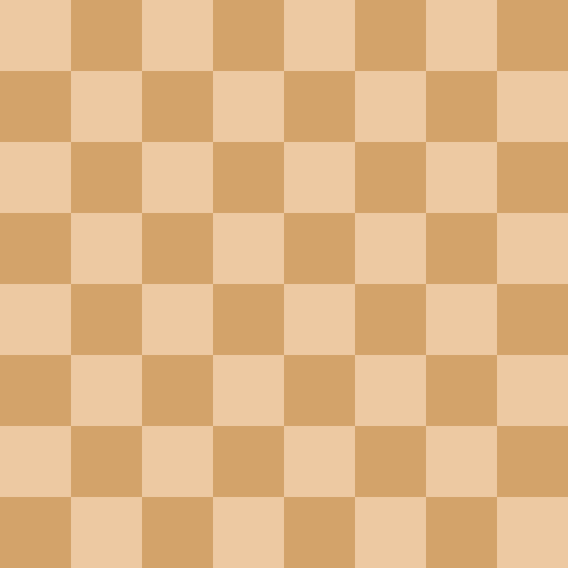

Chess King’s Council
Load Game
New Game

Slide 3
Chess King’s Council
Load Game
New Game
Create Piece

Slide 4
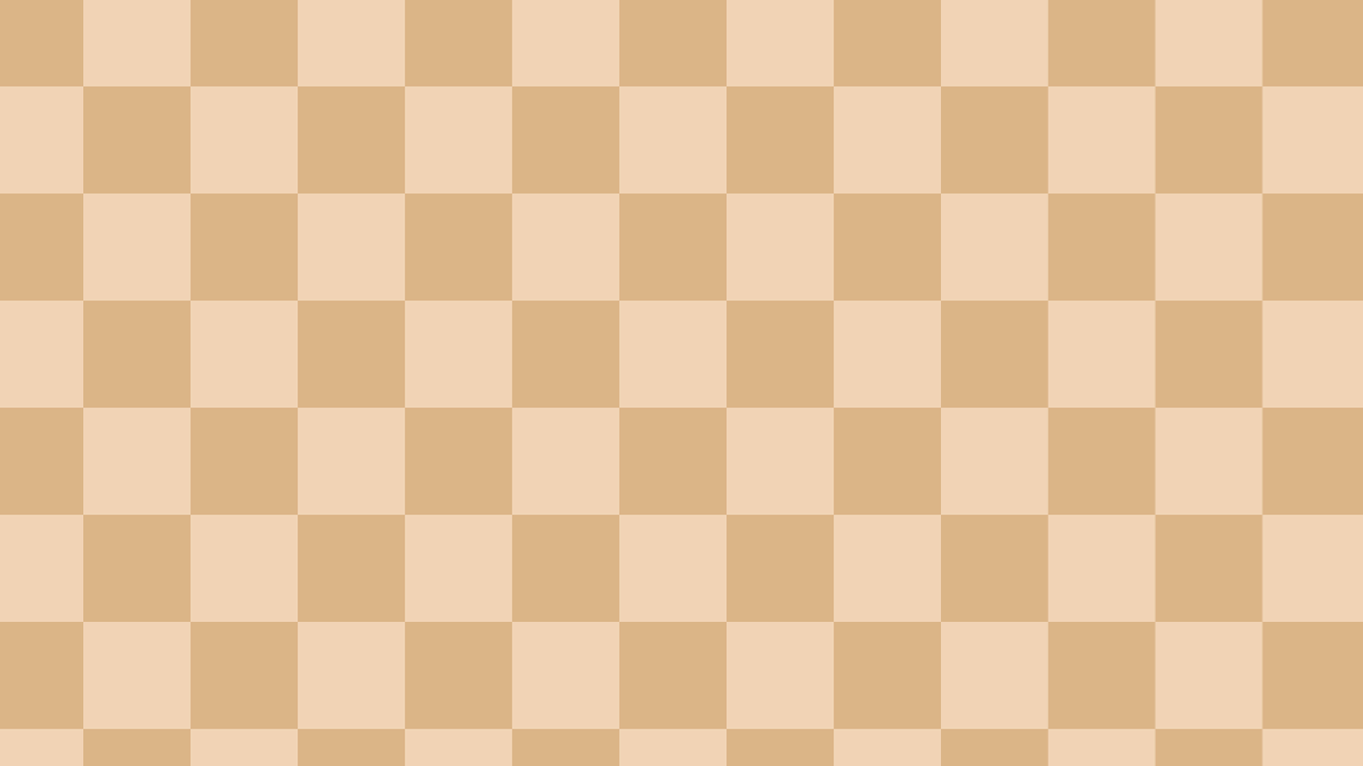

Coming Soon!

Slide 5
Council of Kings

Slide 6
New Game
Play

Slide 7
Enter Name:

Slide 8
Play As:
white
black
test

